Slide 1
DEVELOPMENT OF A SECURE HEALTHCARE MANAGEMENT SYSTEM UTILIZING BLOCKCHAIN TECHNOLOGY FOR ENCRYPTED PATIENT DATA TRANSMISSION

Slide 2
Abstract:
In this project, patients visiting a hospital first consult a general doctor, who updates a prescription with the patient’s ID and medical notes. This prescription is securely shared with other departments—such as surgery, radiology, and pharmacy—where only authorized staff can access it using a department-specific secret key. To ensure security, the prescription is encrypted using the AES algorithm before being sent to each department. Once accessed, department staff can view and proceed with the necessary treatment, updating the patient’s details in the database. For added security, all patient data in the database is encrypted using the SHA-256 algorithm. This system ensures secure, authorized sharing and storage of sensitive medical information across departments.

Slide 3
1.1 INTRODUCTION:
Patients who come to a hospital are first referred to a general doctor. A doctor updates the prescription with the patient's ID and medical notes. Such a prescription is safely shared with other departments: surgery, radiology, and pharmacy, among others. Only by authorized staff, a department-specific secret key can enable access to the prescription. For the purpose of security, a prescription is encrypted using the AES algorithm before sending it to each department. Such information, accessed only by staff in the department, can be viewed to continue the required treatment. Then, patient details are updated in the database. All patient data in the database is encrypted with the SHA-256 algorithm for extra security. Thus, sensitive medical information is shared and stored across departments securely, accessible only to authorized personnel.

Slide 4
Existing System | Proposed System
The emergence of cloud computing enables various healthcare institutions to outsource pre-diagnostic models and provide timely and convenient services for patients. However, healthcare institutions and patients have serious concerns about potential privacy leakage as cloud servers cannot be fully trusted. | In response to privacy concerns in healthcare, the proposed system adopts edge computing and blockchain technology. Edge devices process patient data locally, ensuring confidentiality, while blockchain establishes a secure ledger for data access. Patients retain control over their encrypted medical data, granting access only to authorized healthcare professionals. This decentralized approach enhances trust and transparency, safeguarding patient privacy without reliance on cloud computing.
Techniques: MAFRL method , kNN-based pre-diagnosis with linear complexity k-Nearest Neighbor (kNN), and Mahalanobis Distance (MD) | Techniques: AES Algorithm , OPEN SOURCE Blockchain , sha256
Demerits: It requires high energy utilization contrasted with other agreement conventions. Information exchange is unreliable | Merits: Privacy Protection: Ensuring the confidentiality and security of sensitive patient information. Edge Computing: Processing data locally on devices within the healthcare institution rather than relying on centralized cloud servers. Blockchain Technology: A decentralized and secure ledger system for recording and managing data access and transactions. Data Sovereignty: Giving patients control over their medical data, allowing them to manage access permissions. Security: Measures taken to protect data from unauthorized access, modification, or disclosure.

Slide 5
Objectives:
Enhance Data Security and Integrity: Utilize blockchain technology to create a secure and immutable ledger for recording patient data, ensuring that information remains accurate and protected from unauthorized alterations or tampering.
Streamline Specialist and Department Integration: Develop a system where various healthcare professionals, including client specialists, radiologists, surgeons, and pharmacists, can efficiently register, log in, and access patient data through a structured endorsement process by administrators.
Maintain Confidentiality: Implement a unique encrypted identifier system for patient data to prevent misuse and ensure that sensitive information is only accessible by authorized personnel within different departments.
Facilitate Efficient Data Handling: Enable seamless communication between healthcare departments by forwarding unique encrypted identifiers, ensuring that patient information is correctly and securely processed across different stages of care.
Ensure Compliance and Reliability: Create a reliable and compliant system that adheres to healthcare data protection standards, fostering trust among patients and healthcare providers by ensuring the confidentiality and integrity of patient information.

Slide 6
Scope:
User Registration and Login:
Client Specialist: Register and log in, with endorsement by administrator support specialists.
Radiologists, Surgeons, and Pharmacists: Register and log in, with endorsement by administrators.
Administrators: Manage the registration and endorsement process for all specialists.
Patient Interaction:
Patient Registration and Login: Patients will register and log in to the web application.
Specialist Interaction: Specialists will provide patients with a unique encrypted identifier after consultation.
Data Forwarding and Processing:
Unique Encrypted Identifier: Specialists will issue a unique encrypted number to patients, which is then forwarded to relevant departments (surgery, radiology, pharmacy).
Data Confidentiality: Ensure that the unique identifier prevents any misuse of patient details.

Slide 7
Blockchain Integration:
Immutable Ledger: Use blockchain to record and verify patient data, enhancing data integrity and security.
Encryption and Access Control: Employ encryption techniques to secure patient data and control access based on role and endorsement.
System Management:
Administrator Oversight: Administrators will oversee the registration, endorsement, and login processes for all users, ensuring compliance and security within the system.

Slide 8
2 LITERATURE SURVEY:
TITLE: Achieving Secure, Verifiable, and Efficient Boolean Keyword Searchable Encryption for Cloud Data
Warehouse
AUTHOR: Thanaruk Theeramunkong, Somchart Fugkeaw
YEAR: · January 2024
DESCRIPTION:
Cloud data warehouse (CDW) platforms have been offered by many cloud service providers to provide abundant storage
and unlimited accessibility service to business users. Sensitive data warehouse (DW) data consisting of dimension and
fact data is typically encrypted before it is outsourced to the cloud. However, the query over encrypted DW is not practically supported by any analytical query tools. The Searchable Encryption (SE) technique is palpable for supporting the
keyword searches over the encrypted data. Although many SE schemes have introduced their own unique
searching methods based on indexing structure on top of

Slide 9
TITLE: MaxD K-means: A clustering algorithm for Auto-generation of centroids and distance of data points in clusters
AUTHOR: Tutut Herawan, Abul Beg
YEAR: · January 2012
DESCRIPTION:
K-Means is one of the unsupervised learning and partitioning clustering algorithms. It is very popular and widely used for its simplicity and fastness. The main drawback of this algorithm is that user should specify the number of cluster in advance. As an iterative clustering strategy, K-Means algorithm is very sensitive to the initial starting conditions. In this paper, we propose a clustering technique called MaxD K-Means clustering algorithm. MaxD K-Means algorithm auto generates initial k (the desired number of cluster) without asking for input from the user. MaxD K-means also used a novel strategy of setting the initial centroids. The experiment of the Max-D means has been conducted using synthetic data, which is taken from the Llyod’s K-Means experiments. The results from the new algorithm show that the number of iteration improves tremendously, and the number of iterations is reduced by confirming an improvement rate is up to 78%

Slide 10
TITLE: Privacy-Preserving Patient-Centric Clinical Decision Support System on Naive Bayesian Classification
AUTHOR: Rongxing Lu, Ximeng Liu , Jianfeng Ma
YEAR: January 2015
DESCRIPTION:
Clinical decision support system (CDSS), which uses advanced data mining techniques to help clinician make proper decisions, has received considerable attention recently. The advantages of CDSS include not only improving diagnosis accuracy but also reducing diagnosis time. Specifically, with large amounts of clinical data generated everyday, na¨ ıve Bayesian classification can be utilized to excavate valuable information to improve CDSS. Although CDSS is quite promising, the flourish of CDSS still faces many challenges including information security and privacy concerns. In this paper, we propose a new privacy preserving patient-centric clinical decision support system, called PPCD, which helps clinician complementary to diagnose the risk of patients’ disease in a privacy-preserving way. In PPCD, the past patients’ historical data are stored in cloud and can be used to train the na¨ ıve Bayesian classifier without leaking any individual patient medical data, and then the trained classifier can be applied to compute the disease risk for new

Slide 11
2.2 METHODOLOGIES
Methodologies is the process of analyzing the principles or procedure of a Progressive Anonymous Database management system.
2.2.1 MODULES:

Slide 12
MODULE NAMES:
USER
DOCTORS
SURGEON
RADIOLOGIST
PHARMACIST
ADMIN

Slide 13
2.2.2 MODULE DESCRIPTION:
USER REGISTER AND LOGIN:
This is the first module in our project, here symbolizes a unit of work performed within a database management system (or similar system) against a database, and treated in a coherent and reliable way independent of other transactions. A transaction generally represents any change in database user will transfer the amount to provider. They registered with datas and then login

Slide 14
6. PHARMACIST REGISTER AND LOGIN:
This is the first module in our project, here symbolizes a unit of work performed within a database management system (or similar system) against a database, and treated in a coherent and reliable way independent of other transactions. A transaction generally represents any change in database user will transfer the amount to provider. They registered with datas and then login

Slide 15
. SURGEON REGISTER AND LOGIN:
This is the first module in our project, here symbolizes a unit of work performed within a database management system (or similar system) against a database, and treated in a coherent and reliable way independent of other transactions. A transaction generally represents any change in database user will transfer the amount to provider. They registered with datas and then login
5. RADIOLOGIST REGISTER AND LOGIN:
This is the first module in our project, here symbolizes a unit of work performed within a database management system (or similar system) against a database, and treated in a coherent and reliable way independent of other transactions. A transaction generally represents any change in database user will transfer the amount to provider. They registered with datas and then login

Slide 16
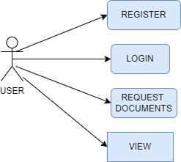
USE CASE DIAGRAM:

Slide 17
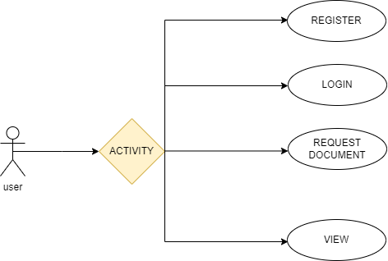
ACTIVITY DIAGRAM :

Slide 18
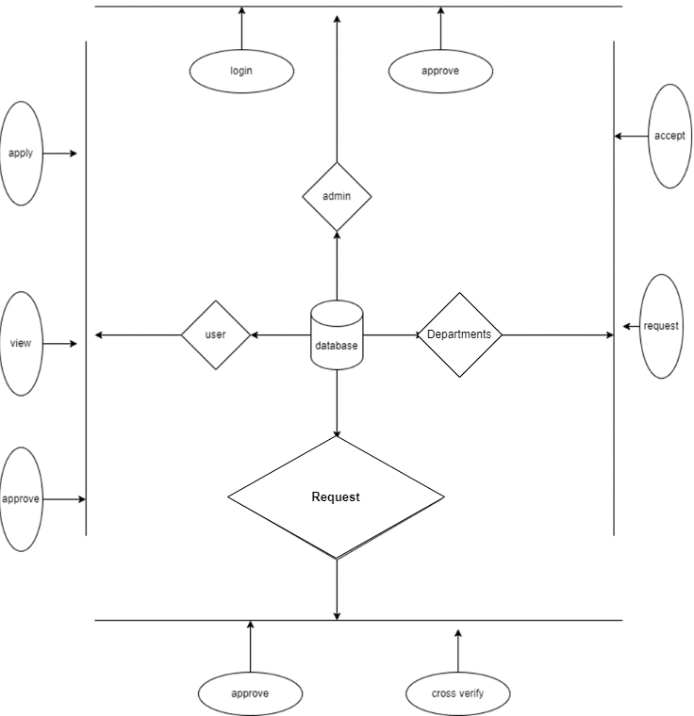
E-R DIAGRAM:

Slide 19
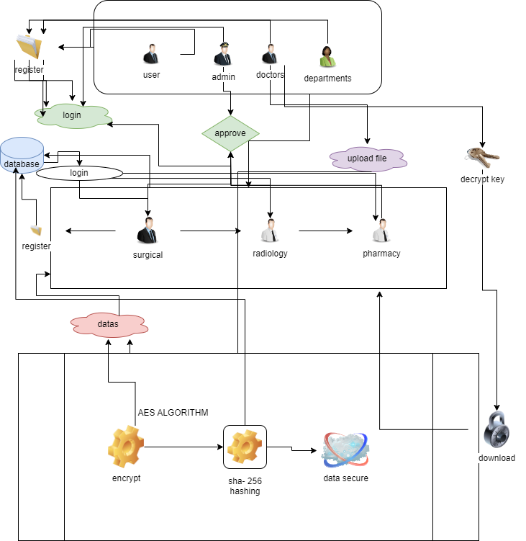
SYSTEM ARCHITECTURE:

Slide 20
CODINGS:
<!DOCTYPE html>
<html lang="en" xmlns:th="http://www.thymeleaf.org">
<head>
<meta charset="UTF-8">
<meta name="viewport" content="width=device-width, initial-scale=1.0">
<title>Welcome | Doctors</title>
<link href="https://cdn.jsdelivr.net/npm/bootstrap@5.0.2/dist/css/bootstrap.min.css" rel="stylesheet" integrity="sha384-EVSTQN3/azprG1Anm3QDgpJLIm9Nao0Yz1ztcQTwFspd3yD65VohhpuuCOmLASjC" crossorigin="anonymous">
<script src="https://cdn.jsdelivr.net/npm/bootstrap@5.0.2/dist/js/bootstrap.bundle.min.js" integrity="sha384-MrcW6ZMFYlzcLA8Nl+NtUVF0sA7MsXsP1UyJoMp4YLEuNSfAP+JcXn/tWtIaxVXM" crossorigin="anonymous"></script>
<link rel="shortcut icon" href="C:\Users\saura\Downloads\fabicon-removebg-preview (2).png">
<body>
<!-- Header -->

Slide 21
<header>
<div class="motto"><b>Welcome</b></div>
<div class="slideshow">
<img src="https://encrypted-tbn0.gstatic.com/images?q=tbn:ANd9GcRdji1931PbuaaeOzkiWxZwCP0Y-l4Xi1WwR1sD38DAMHght4-40fDGDgm8uf3LQa0zNBU&usqp=CAU" alt="Image 1">
<img src="https://t3.ftcdn.net/jpg/05/65/55/96/360_F_565559600_YuYjetRZf0xO4hEzElmYPtWXI7bdpXeE.jpg" alt="Image 2">
<img src="https://plus.unsplash.com/premium_photo-1674841252366-162fc9b8f983?q=80&w=1887&auto=format&fit=crop&ixlib=rb-4.0.3&ixid=M3wxMjA3fDB8MHxwaG90by1wYWdlfHx8fGVufDB8fHx8fA%3D%3D" alt="Image 3">
<img src="https://plus.unsplash.com/premium_photo-1673351534430-f5dde7d87a60?q=80&w=2002&auto=format&fit=crop&ixlib=rb-4.0.3&ixid=M3wxMjA3fDB8MHxwaG90by1wYWdlfHx8fGVufDB8fHx8fA%3D%3D" alt="Image 4">
<img src="https://plus.unsplash.com/premium_photo-1682141160157-d6a296a65574?q=80&w=1932&auto=format&fit=crop&ixlib=rb-4.0.3&ixid=M3wxMjA3fDB8MHxwaG90by1wYWdlfHx8fGVufDB8fHx8fA%3D%3D" alt="Image 5">
<img src="https://plus.unsplash.com/premium_photo-1674499074438-8f611a3569f6?q=80&w=2069&auto=format&fit=crop&ixlib=rb-4.0.3&ixid=M3wxMjA3fDB8MHxwaG90by1wYWdlfHx8fGVufDB8fHx8fA%3D%3D"

Slide 22
<img src="https://images.unsplash.com/photo-1505751172876-fa1923c5c528?q=80&w=2070&auto=format&fit=crop&ixlib=rb-4.0.3&ixid=M3wxMjA3fDB8MHxwaG90by1wYWdlfHx8fGVufDB8fHx8fA%3D%3D" alt="Image 9">
<img src="https://images.unsplash.com/photo-1578496479763-c21c718af028?q=80&w=2070&auto=format&fit=crop&ixlib=rb-4.0.3&ixid=M3wxMjA3fDB8MHxwaG90by1wYWdlfHx8fGVufDB8fHx8fA%3D%3D" alt="Image 10">
<img src="https://images.unsplash.com/photo-1543333995-a78aea2eee50?q=80&w=2070&auto=format&fit=crop&ixlib=rb-4.0.3&ixid=M3wxMjA3fDB8MHxwaG90by1wYWdlfHx8fGVufDB8fHx8fA%3D%3D" alt="Image 11">
<img src="https://images.unsplash.com/photo-1582560469781-1965b9af903d?q=80&w=1993&auto=format&fit=crop&ixlib=rb-4.0.3&ixid=M3wxMjA3fDB8MHxwaG90by1wYWdlfHx8fGVufDB8fHx8fA%3D%3D" alt="Image 12">
<img src="https://plus.unsplash.com/premium_photo-1661779616524-1825ac40c9d6?q=80&w=2070&auto=format&fit=crop&ixlib=rb-4.0.3&ixid=M3wxMjA3fDB8MHxwaG90by1wYWdlfHx8fGVufDB8fHx8fA%3D%3D" alt="Image 13">
</div>
<style>

Slide 23
body {
font-family: Arial, sans-serif;
background-color: #f5f5f5;
color: #333;
margin: 0;
padding: 0;
}
/* Header */
header {
position: relative;
overflow: hidden;
width: 100%;
height: 400px; /* Adjust height as needed */
display: flex;
justify-content: center;
align-items: center;
}

Slide 24
.slideshow img {
width: 25%;
height: auto;
object-fit: cover;
}
@keyframes slideImages {
0% {
transform: translateX(0%);
}
100% {
transform: translateX(-100%);
}
}
.logo {
position: relative;
top: 20px;
left: 10px;

Slide 25
.logo img {
width: 400px; /* Adjust the width of the logo */
height: auto;
filter: brightness(150%); /* Increase brightness for better visibility */
}
.motto {
position: absolute;
bottom: 20px;
left: 50%;
transform: translateX(-50%);
z-index: 1;
color: #FFA500; /* Adjust color for better visibility */
font-size: 24px; /* Increase font size for better visibility */
}
/* Navigation */

Slide 26
.main-content {
padding: 20px;
display: flex;
justify-content: space-between;
align-items: center;
flex-wrap: wrap;
}
.main-content .left-column {
flex: 1;
max-width: 50%;
padding-right: 20px;
}
.main-content .right-column {
flex: 1;
max-width: 50%;
padding-left: 20px;

Slide 27
.services h2 {
text-align: center;
margin-bottom: 20px;
}
.service-container {
display: flex;
justify-content: space-between;
align-items: flex-start;
}
.service {
flex: 1;
margin: 0 10px;
background-color: #fff;
border-radius: 8px;
box-shadow: 0 0 20px rgba(0, 0, 0, 0.1);
overflow: hidden;
}
.service-info {

Slide 28
.service h3 {
margin-bottom: 10px;
color: #333;
}
.service p {
margin-bottom: 20px;
color: #666;
}
.btn {
display: block;
text-align: center;
background-color: #333;
color: #fff;
text-decoration: none;
padding: 10px 20px;
border-radius: 5px;
transition: background-color 0.3s ease;
}

Slide 29
patient-reviews h2 {
margin-bottom: 10px;
text-align: center;
}
.review {
display: flex;
align-items: center;
padding: 15px;
border-bottom: 1px solid #ddd;
}
.review img {
width: 100px;
height: 100px;
border-radius: 50%;
margin-right: 20px;
}
.review-content {
flex: 1;

Slide 30
/* Footer */
footer {
background-color: #333;
color: #fff;
text-align: center;
padding: 10px 0;
}
/* Founders Section Styles */
.founders {
background-color: #f9f9f9; /* Background color similar to other sections */
color: #333; /* Text color similar to other sections */
padding: 50px 0;
text-align: center;

Slide 31
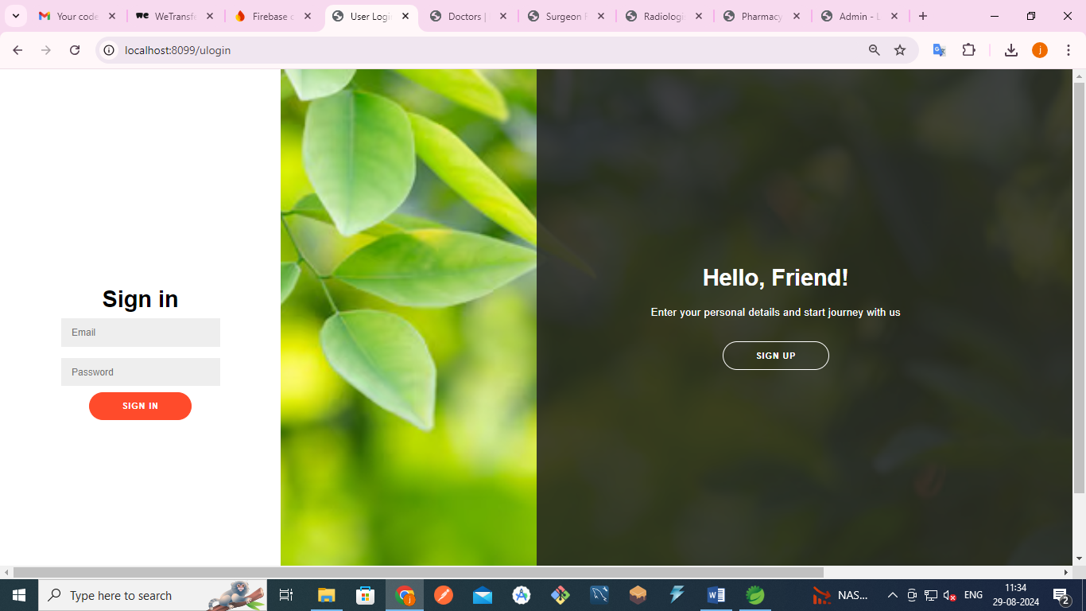
SNAPSHOTS:

Slide 32
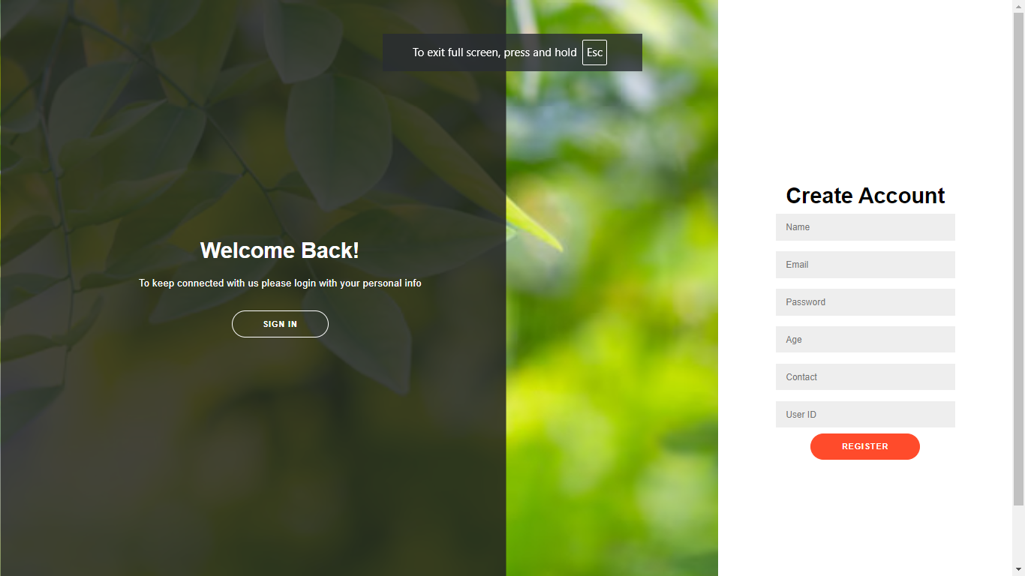

Slide 33
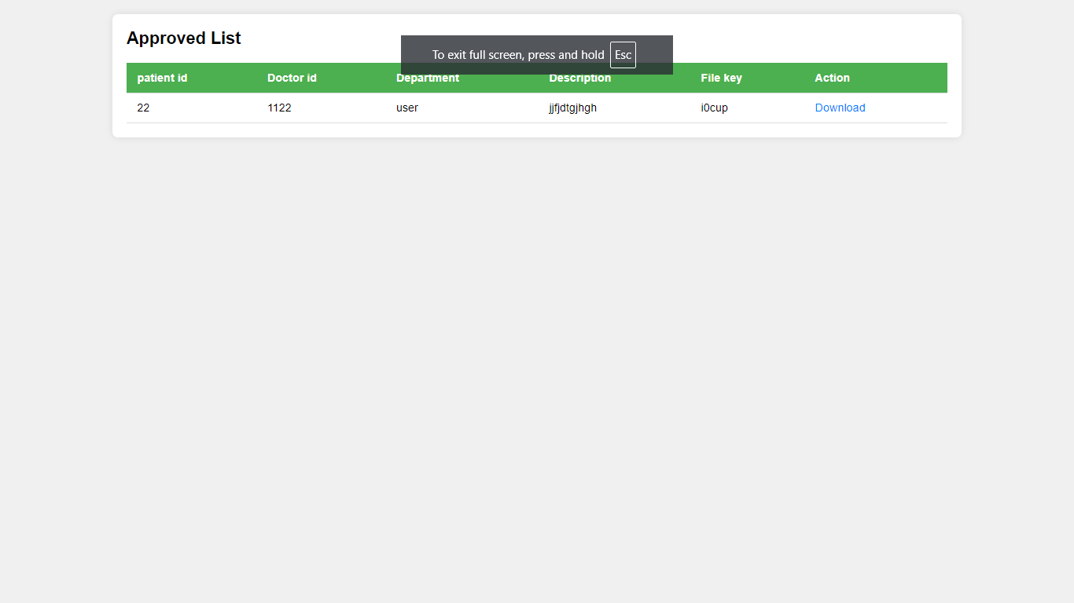

Slide 34
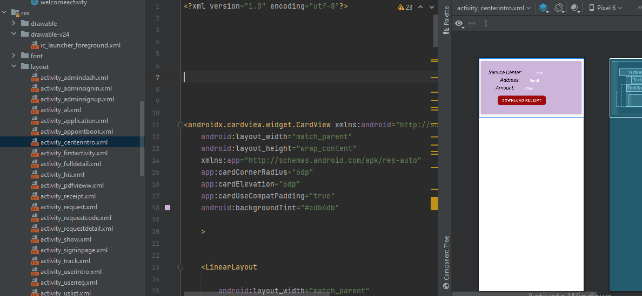

Slide 35
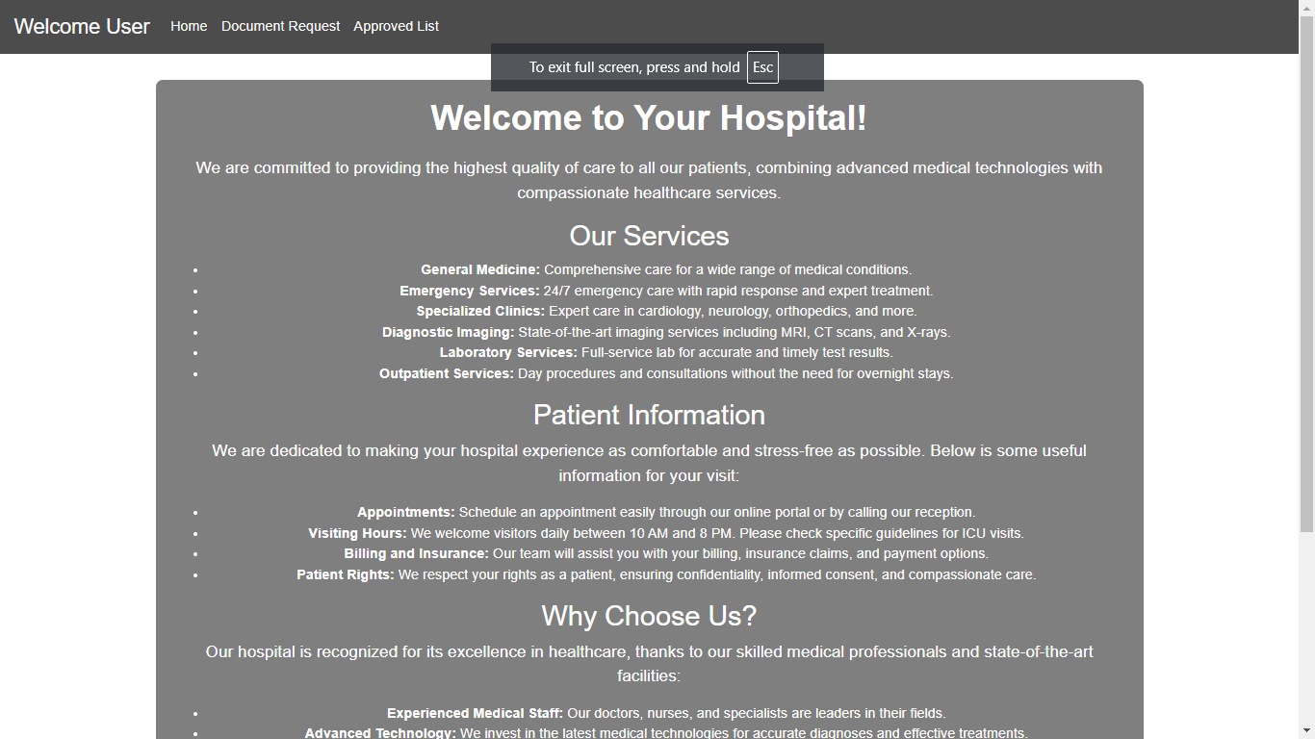

Slide 36
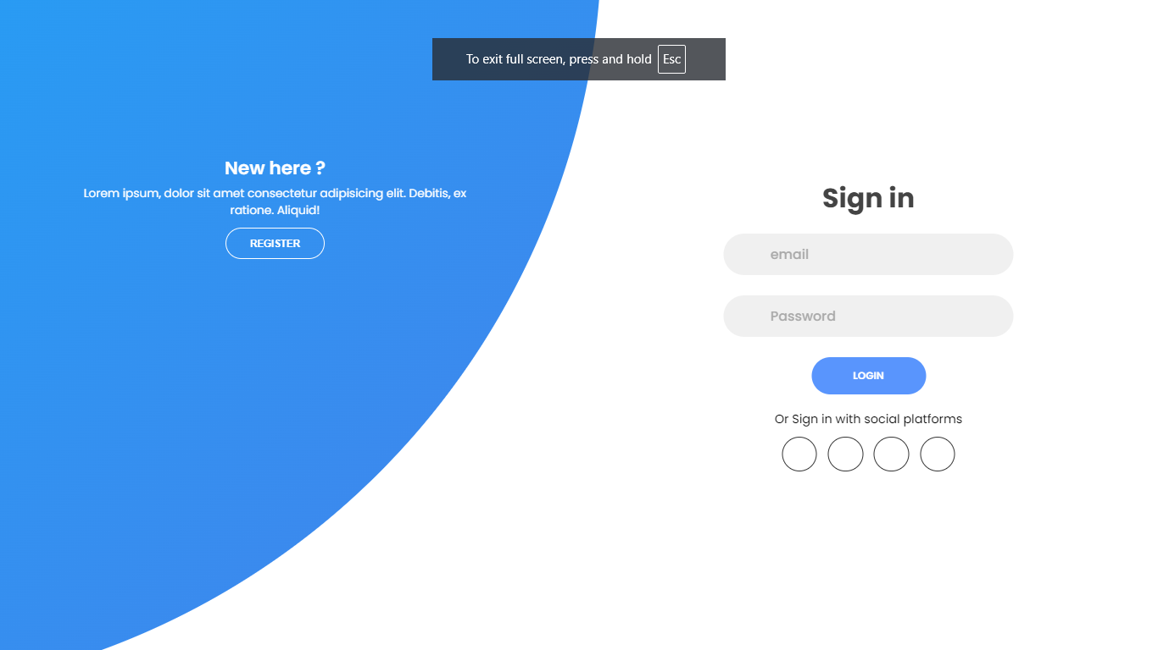

Slide 37
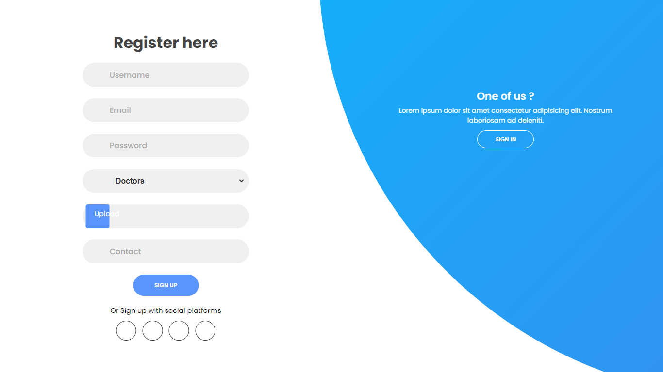

Slide 38
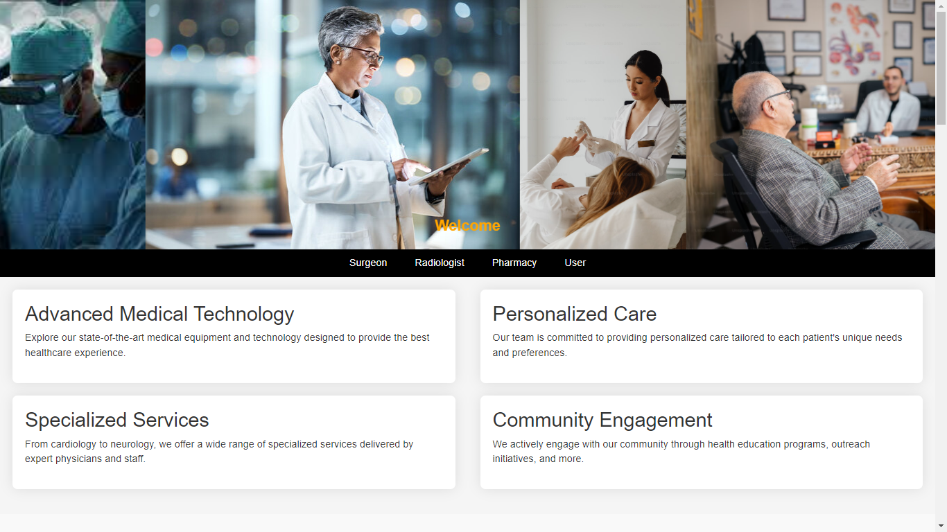

Slide 39
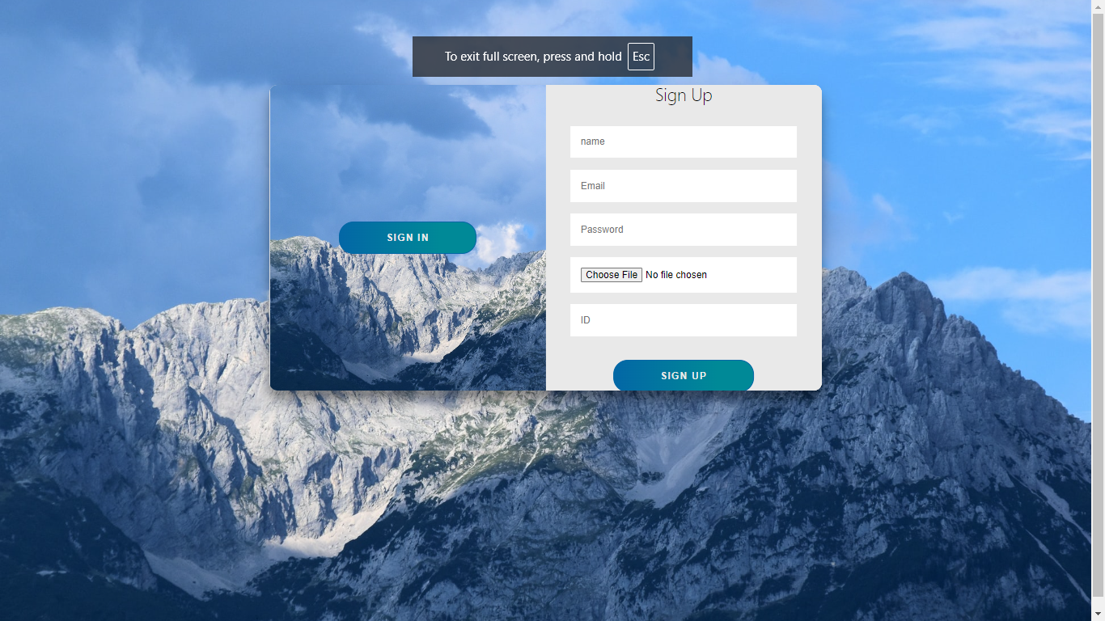

Slide 40
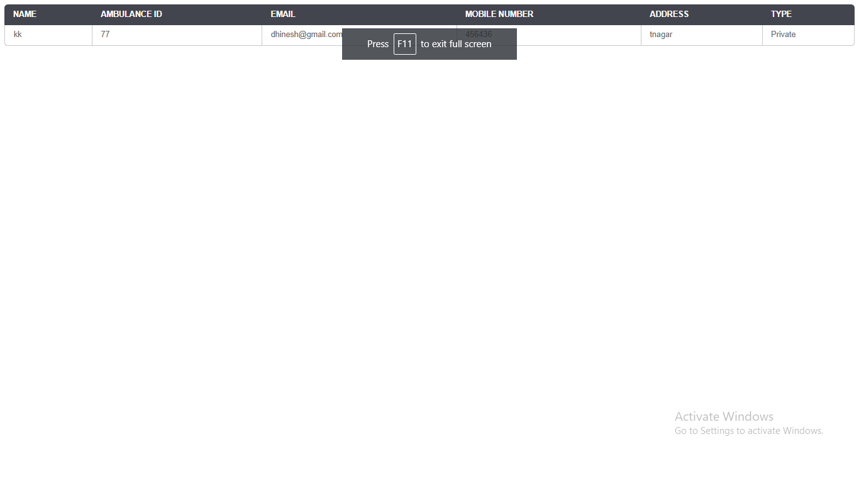

Slide 41
FUTURE ENHANCEMENT:
In future implementation will add some algorithm to implement the project very secure.
And add some module or states to improve more options to implementation.
ADVANTAGES:
Safe and Secure.
Analysis the file request.
Take a survey in file response by to modules.

Slide 42
CONCLUSION:
In summary, your project integrates blockchain technology to enhance the integrity and confidentiality of patient data within a healthcare system. The system involves multiple roles, including client specialists, radiologists, surgeons, pharmacists, and administrators, each with specific responsibilities and access rights. After a patient registers and logs in, they receive a unique encrypted number from their specialist, which is then forwarded to various departments such as surgery, radiology, and pharmacy. This unique number ensures that sensitive patient information is protected and cannot be misused. The blockchain framework guarantees data integrity by providing an immutable ledger, while encryption and a structured endorsement process safeguard patient confidentiality. This approach not only streamlines data handling across different departments but also builds a secure and reliable system that fosters trust and efficiency in patient care.

Slide 43
REFERENCES:
[1] The Radicati Group Inc., “Cloud Email and Collaboration-Market Quadrant 2019,” https://
www.radicati.com/wp/wp-content/uploads/2019/03/ Cloud-Email-and-Collaboration-Market-Quadrant-2019-Brochure. pdf, March 2019, accessed April 8, 2019.
[2] Tim Sadler, “The Year of Email Data Breaches,” https://www.infosecurity magazine.com/opinions/
2017-email-data-breaches/, January 2018, accessed September 11,
2019017 IEEE Symposium on Security and Privacy. IEEE, 2017, pp. 137–153.

Slide 44
[8] S. Ruoti, J. Andersen, D. Zappala, and K. Seamons. (2015) Why johnny still, still can’t encrypt: Evaluating the usability of a modern pgp client. [Online]. Available: https://arxiv.org/pdf/ 1510.08555.pdf
[9] S. Sheng, L. Broderick, C. A. Koranda, and J. J. Hyland, “Why johnny still can’t encrypt: evaluating the usability of email encryption software,” in Symposium On Usable Privacy and Security, 2006, pp. 3–4.
[10] A. Shamir, “Identity-based cryptoystems and signature schemes,” in Advances in Cryptology–CRYPTO 1984. Springer, 1984, pp. 47– 53.

